Slide 1
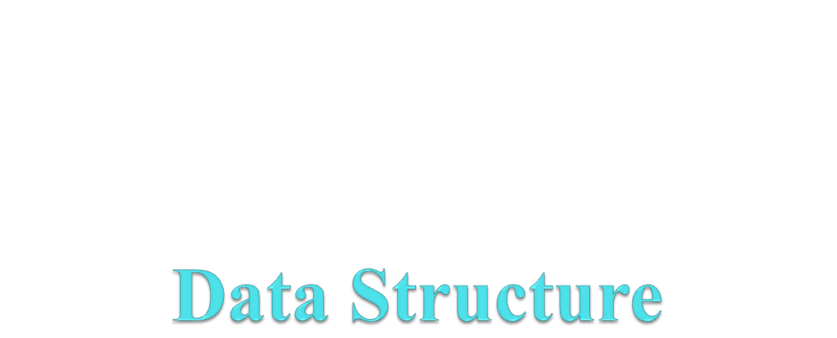
Yogesh Sharma

Slide 2

General Instructions
Keep your camera switch ON and audio OFF during Class.
Eatables not allowed during the class.
Drinking water is allowed during the class.
Maintain the decorum and discipline of the class.
Yogesh Sharma

Slide 3
Course Information
Text Books:
[1] R. F. Gilberg, and B. A. Forouzan, “Data structures: A Pseudocode approach with C”, Thomson Learning.
[2] A.V. Aho, J. E. Hopcroft, J. D. Ulman “Data Structures and Algorithm”, Pearson Education.
Other Books:
[1] Seymour Lipschutz, “Data Structures with C (Schaum's Outline Series) Paperback”, McGrawHill.
[2] G.S. Baluja , “Data Structures Through C (A Practical Approach)”, Dhanpat Rai & Co.
Reference Books:
[1] S. Sahni and E. Horowitz, “Data Structures”, Galgotia Publications.
[2] Tanenbaum: “Data Structures using C”, Pearson/PHI.
[3] T.H. Cormen, C. E. Leiserson, R. L. Rivest “Introduction to Algorithms”, PHI/Pearson.
[4] A.K.Sharma, “Data Structures”, Pearson [R5] Ellis Horowitz and Sartaz Sahani “Fundamentals of Computer Algorithms”, Computer Science Press
Yogesh Sharma

Slide 4
Syllabus
UNIT – 1: Introduction to programming methodologies and design of algorithms. Abstract Data Type, array, array organization, sparse array. Stacks and Stack ADT, Stack Manipulation, Prefix, infix and postfix expressions, their interconversion and expression evaluation. Queues and Queue ADT, Queue manipulation. General Lists and List ADT, List manipulations, Single, double and circular lists.
UNIT – II: Trees, Properties of Trees, Binary trees, Binary Tree traversal, Tree manipulation algorithms, Expression trees and their usage, binary search trees, AVL Trees, Heaps and their implementation.
UNIT – III: Multiway trees, B-Trees, 2-3 trees, 2-3-4 trees, B* and B+ Trees. Graphs, Graph representation, Graph traversal.
UNIT – IV: Sorting concept, order, stability, Selection sorts (straight, heap), insertion sort (Straight Insertion, Shell sort), Exchange Sort (Bubble, quicksort), Merge sort (only 2-way merge sort). Searching – List search, sequential search, binary search, hashing concepts, hashing methods (Direct, subtraction, modulo-division, midsquare, folding, pseudorandom hashing), collision resolution (by open addressing: linear probe, quadratic probe, pseudorandom collision resolution, linked list collision resolution), Bucket hashing.
Yogesh Sharma

Slide 5
Importance of Data Structures
Data structures are essential for managing large amounts of data, such as information kept in databases or indexing services, efficiently.
Proper maintenance of data systems requires the identification of memory allocation, data interrelationships and data processes, all of which data structures help with.
Additionally, it is not only important to use data structures but it is important to choose the proper data structure for each task.
Choosing an ill-suited data structure could result in slow runtimes or unresponsive code.
Factors to consider when picking a data structure include what kind of information will be stored, where should existing data be placed, how should data be sorted and how much memory should be reserved for the data.
Yogesh Sharma

Slide 6
Applications of Data Structures
In web- browsers, it creates a web pages linked with each other when visited, when you check history or press back button, the previous node’s data is fetched.
An “undo” mechanism in the text editors; this operation is accomplished by keeping all the text changes in form of a stack.
When a resource is shared among multiple consumers like CPU scheduling, Disk Scheduling, also in printers.
Opening of folders in drive( cmd tree).
Yogesh Sharma

Slide 7
Programming Methodologies
What is Programming Methodology ?
Approach to analyzing complex problems.
Planning for software development.
Controlling the development process.
Yogesh Sharma

Slide 8
Types of Programming Methodologies
Procedural Programming
Problem is broken down into procedures, or blocks of code that perform one task each. All procedures taken together form the whole program. It is suitable only for small programs that have low level of complexity like C, FORTRAN, PASCAL.
Object-oriented Programming
Solution revolves around entities or objects that are part of problem like C++.
Functional Programming
Here the problem, or the desired solution, is broken down into functional units. Each unit performs its own task and is self-sufficient. These units are then stitched together to form the complete solution like Python
Logical Programming
Here the problem is broken down into logical units rather than functional units like PROLOG
Yogesh Sharma

Slide 9
Algorithm
A finite set of steps that must be followed to solve any problem is called an algorithm.
Algorithm is generally developed before the actual coding is done.
It is written using English like language so that it is easily understandable even by non-programmers.
Sometimes algorithms are written using pseudocodes, i.e. a language similar to the programming language to be used.
Yogesh Sharma

Slide 10
How to Formulate an Algorithm
Determine the outcome of your code.
Decide on a starting point.
Find the ending point of the algorithm.
List the steps from start to finish.
Determine how you will accomplish each step.
Review the algorithm.
Yogesh Sharma

Slide 11
Abstract Data Type
Abstract Data type (ADT) is a type (or class) for objects whose behavior is defined by a set of value and a set of operations.
ADTs support abstraction, encapsulation, and information hiding.
Abstraction is the structuring of a problem into well-defined entities by defining their data and operations.
The principle of hiding the used data structure and to only provide a well-defined interface is known as encapsulation.
Yogesh Sharma

Slide 12
Abstract Data Type and Data Structure
Definition:-
  Abstract Data Types (ADTs) stores data and allow various operations on the data to access and change it.
  A mathematical model, together with various operations defined on the model
  An ADT is a collection of data and associated operations for manipulating that data.
Data Structures
  Physical implementation of an ADT
  Data structures used in implementations are provided in a language (primitive or built-in) or are built from the language constructs (user-defined)
  Each operation associated with the ADT is implemented by one or more subroutines in the implementation.
  ADTs namely List ADT, Stack ADT, Queue ADT.
Yogesh Sharma

Slide 13
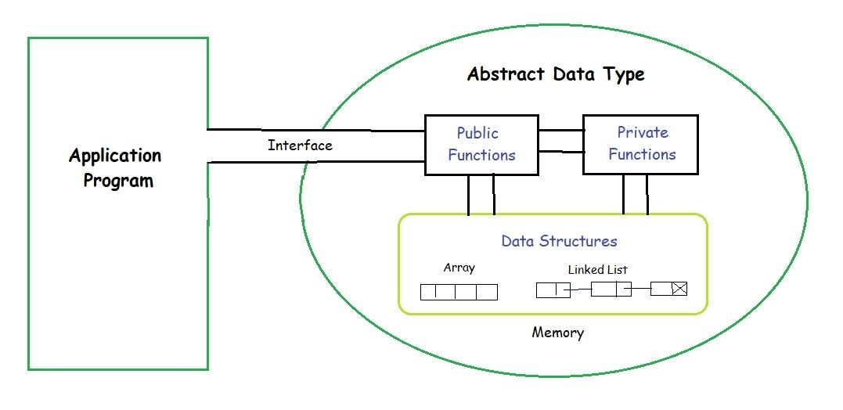
Yogesh Sharma

Slide 14
The Core Operations of ADT
Every Collection ADT should provide a way to:
  add an item
  remove an item
  find, retrieve, or access an item
Many, many more possibilities
  is the collection empty
  make the collection empty
  give me a sub set of the collection
  No single data structure works well for all purposes, and so it is important to know the strengths and limitations of several of them
Yogesh Sharma

Slide 15
What is Data Structure?
Data structure is a representation of data and the operations allowed on that data.
  A data structure is a way to store and organize data in order to facilitate the access and modifications.
  Data Structure are the method of representing of logical relationships between individual data elements related to the solution of a given problem.
Yogesh Sharma

Slide 16
Why We Need Data Structures
Each data structure allows data to be stored in a specific manner .
Data structures allows efficient data search and retrieval .
Specific data structures are decided to work for specific problems because each of them have specific specialties.
It allows to manage large amounts of data such as large databases and indexing services such as hash tables.
Real-world scenario and data structure emulates that simulates that exact scenario in the digital world.
Yogesh Sharma

Slide 17

Dictionary as Data Structure
Yogesh Sharma

Slide 18
Basic Data Structure
Basic Data Structures
Linear Data Structures
Non-Linear Data Structures
Arrays
Linked Lists
Stacks
Queues
Trees
Graphs
Hash Tables
Yogesh Sharma

Slide 19
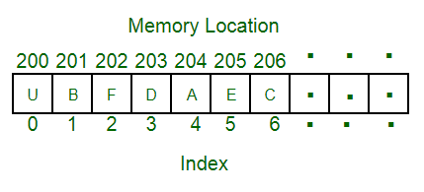
Array
array
An array is a collection of data items, all of the same type, accessed using a common name.
A one-dimensional array(1D) is like a list.
A two dimensional array (2D)is like a table.
The C language places no limits on the number of dimensions in an array.
Yogesh Sharma

Slide 20
One-Dimensional (1-D) Array
1 | 2 | 3 | 4 | 5 | 6 | 7 | 8 | 9 | 0
1 | 2
3 | 4
1 | 2 | 3
4 | 5 | 6
7 | 8 | 9
Two-Dimensional (2-D) Array
Three-Dimensional (3-D) Array
Yogesh Sharma

Slide 21
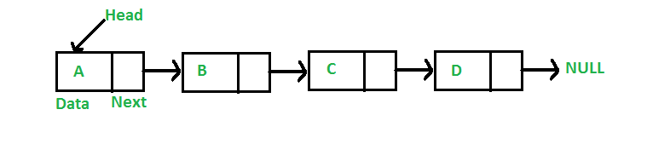
Linked List
Linked list
In computer science, a linked list is a linear collection of data elements whose order is not given by their physical placement in memory.
Instead, each element points to the next. It is a data structure consisting of a collection of nodes which together represent a sequence
Yogesh Sharma

Slide 22
Array Vs Linked List
An array is the data structure that contains a collection of similar type data elements whereas the Linked list is considered as non-primitive data structure contains a collection of unordered linked elements known as nodes.
Elements are stored consecutively in arrays whereas it is stored randomly in Linked lists.
Accessing an element in an array is fast, while Linked list takes linear time, so it is quite a bit slower.
Operations like insertion and deletion in arrays consume a lot of time. On the other hand, the performance of these operations in Linked lists is fast.
Arrays are of fixed size. In contrast, Linked lists are dynamic and flexible and can expand and contract its size.
In an array, memory is assigned during compile time while in a Linked list it is allocated during execution or runtime.
Yogesh Sharma

Slide 23
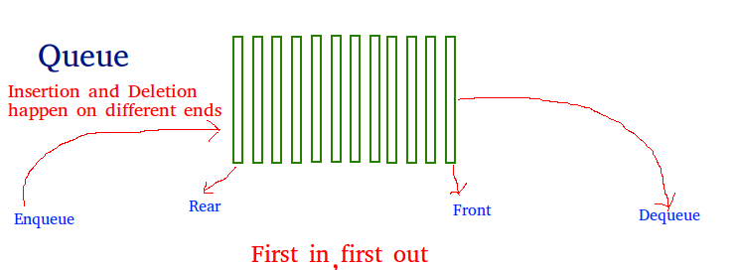
Queue
Queue
A Queue is a linear structure which follows a particular order in which the operations are performed. The order is First In First Out (FIFO).
A good example of a queue is any queue of consumers for a resource where the consumer that came first is served first.
Yogesh Sharma

Slide 24
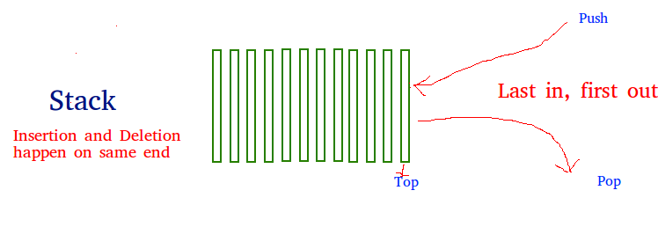
Stack
stack
Stack is a linear data structure which follows a particular order in which the operations are performed.
The order may be LIFO(Last In First Out) or FILO(First In Last Out).
Yogesh Sharma

Slide 25
Non- Linear Data Structure
Yogesh Sharma

Slide 26
Tree
tree
A tree is a nonlinear data structure, compared to arrays, linked lists, stacks and queues which are linear data structures.
A tree can be empty with no nodes or a tree is a structure consisting of one node called the root and zero or one or more subtrees.
Yogesh Sharma

Slide 27
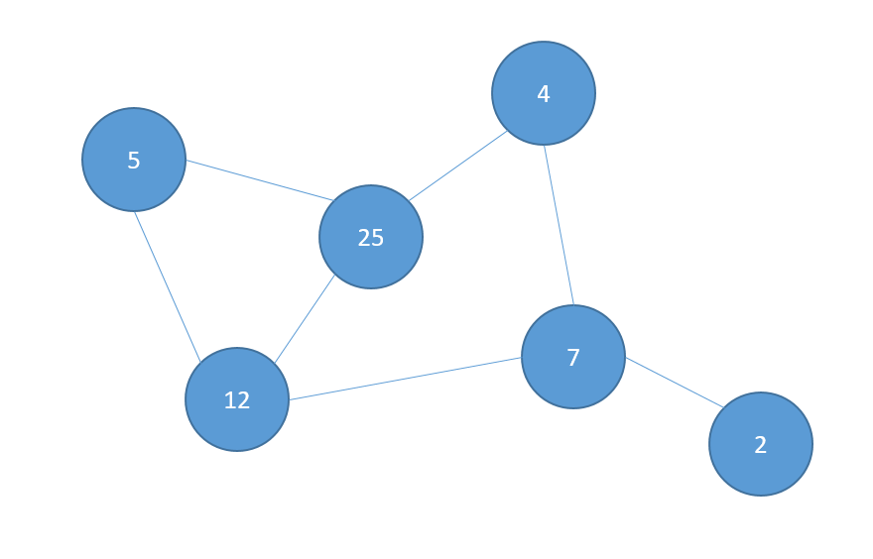
Graph
A Graph is a non-linear data structure consisting of nodes and edges.
The nodes are sometimes also referred to as vertices and the edges are lines or arcs that connect any two nodes in the graph.
Yogesh Sharma

Slide 28
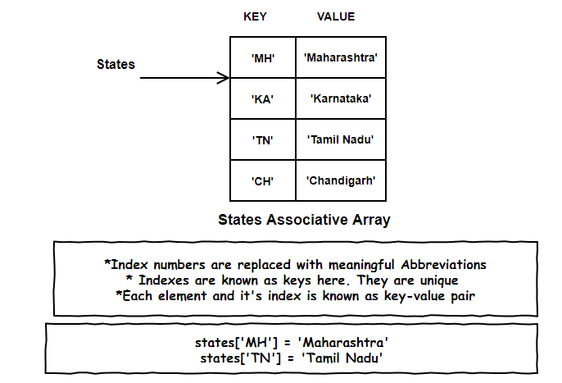
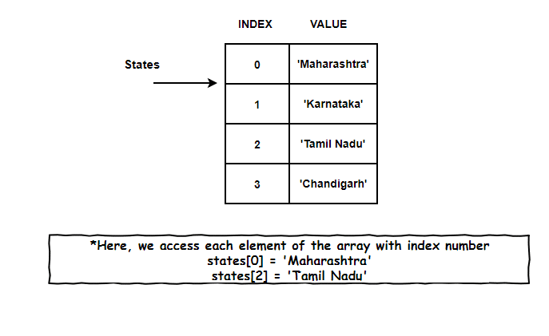
Hash Table
Hash Table is a data structure which stores data in an associative manner. In a hash table, data is stored in an array format, where each data value has its own unique index value.
Access of data becomes very fast if we know the index of the desired data.
Hash Table uses an array as a storage medium and uses hash technique to generate an index where an element is to be inserted or is to be located from.
Yogesh Sharma

Slide 29
Selection of Data Structure
The choice of particular data model depends on two consideration:
  It must be rich enough in structure to represent the relationship between data elements
  The structure should be simple enough that one can effectively process the data when necessary
Yogesh Sharma

Slide 30
Type of Data Structures
Homogenous: In this type of data structures, values of the same types of data are stored.
  Array
Non-Homogenous: In this type of data structures, data values of different types are grouped and stored.
  Structures
  Classes
Yogesh Sharma

Slide 31
OPERATIONS ON ARRAYS
Various operations that can be performed on an array
Traversing
Insertion
Deletion
Sorting
Searching
Merging
Yogesh Sharma

Slide 32
Traversing Linear Array:
Let A be a collection of data elements stored in the memory of the computer.
Suppose we want to print the content of each element of A or suppose we want to count the number of elements of A, this can be accomplished by traversing A, that is, by accessing and processing each element of a exactly ones.
Yogesh Sharma

Slide 33
The following algorithm traverses a linear array LA. The simplicity of the algorithm comes from the fact that LA is a linear structure.
Algorithm: (Traversing a Linear Array) Here LA is a linear array with lower bound LB and upper bound UB. This algorithm traverses LA applying an operation PROCESS to each element of LA.
1. [Initialize counter] Set k: =LB.
2. Repeat steps 3 and 4 while k <=UB.
3. [Visit Element] Apply PROCESS to LA [k].
4. [Increase Counter] Set k: =k + 1.
[End of step 2 loop]
5. Exit.
Yogesh Sharma

Slide 34
Insertion and Deletion in Linear Array:
Let A be a collection of data elements in the memory of the computer.
“Inserting "refers to the operation of adding another element to the collection A
“Deleting” refers to the operation of removing one element from A.
Yogesh Sharma

Slide 35
Insertion in Linear Array:
Inserting an element at the end of the linear array can be easily done provided the memory space allocated for the array is large enough to accommodate the additional element.
We need to insert an element in the middle of the array. Then, on the average, half of the elements must be moved downward to new location to accommodate the new elements and keep the order of the other elements.
Yogesh Sharma

Slide 36
Deletion in Linear Array:
Deleting an element at the end of the array presents no difficulties.
Deleting the element somewhere in the middle of the array requires that each subsequent element be moved one location upward in order to fill up the array.
Yogesh Sharma

Slide 37
Algorithm for Insertion:
(Inserting into Linear Array) INSERT (LA, N, K, ITEM) Here LA is a linear array with N elements and K is a positive integer such that K<=N. The algorithm inserts an element ITEM into the Kth position in LA.
Yogesh Sharma

Slide 38
[Initialize counter] Set J: = N.
2. Repeat Steps 3 and 4 while j >= k;
3. [Move jth element downward.] Set LA [J + 1]: =LA [J].
4. [Decrease counter] Set J: = J-1 [End of step 2 loop] 5. [Insert element] Set LA [K]:=ITEM.
6. [Reset N] Set N:=N+1
7. EXIT.
The following algorithm deletes the Kth element from a linear array LA and assigns it to a variable ITEM.
Yogesh Sharma

Slide 39
Algorithm for Deletion: (Deletion from a Linear Array)
DELETE (LA, N, K, ITEM) Here LA is a Linear Array with N elements and K is the positive integer such that K<=N. This algorithm deletes the Kth element from LA.
1. Set ITEM: = LA [k].
2. Repeat for J = K to N – 1.
[Move J + 1st element upward] Set LA [J]: = LA [J +1].
[End of loop]
3. [Reset the number N of elements in LA] Set N: = N-1 4. EXIT
Yogesh Sharma

Slide 40
Multidimensional Array
Array having more than one subscript variable is called Multi-Dimensional array.
Multi Dimensional Array is also called as Matrix.
Yogesh Sharma

Slide 41
Consider the Two dimensional array –
1. Two Dimensional Array requires Two Subscript Variables
2. Two Dimensional Array stores the values in the form of matrix.
3. One Subscript Variable denotes the “Row” of a matrix.
4. Another Subscript Variable denotes the “Column” of a matrix
Yogesh Sharma

Slide 42
Declaration and Use of Two Dimensional Array
int a[3][4];
Use:
for(i=0;i<row;i++)
{
for(j=0;j<col;j++)
{
printf("%d",a[i][j]);
}
}
int a[3][4];
Use:
for(i=0;i<3;i++)
{
for(j=0;j<4;j++)
{
printf("%d",a[i][j]);
}
}
a[i][j]
A[0][0] a[1][0]
A[0][1] a[1][1]
A[0][2]
A[0][3]
A[0][4]
Yogesh Sharma

Slide 43
Meaning of Two Dimensional Array :
1. Matrix is having 3 rows ( i takes value from 0 to 2 )
2. Matrix is having 4 Columns ( j takes value from 0 to 3 )
3. Above Matrix 3×4 matrix will have 12 blocks having 3
rows & 4 columns.
4. Name of 2-D array is ‘a’ and each block is identified by
the row & column number.
5. Row number and Column Number Starts from 0.
Yogesh Sharma

Slide 44
Cell Location | Meaning
a[0][0] | 0th Row and 0th Column
a[0][1] | 0th Row and 1st Column
a[0][2] | 0th Row and 2nd Column
a[0][3] | 0th Row and 3rd Column
a[1][0] | 1st Row and 0th Column
a[1][1] | 1st Row and 1st Column
a[1][2] | 1st Row and 2nd Column
a[1][3] | 1st Row and 3rd Column
a[2][0] | 2nd Row and 0th Column
a[2][1] | 2nd Row and 1st Column
a[2][2] | 2nd Row and 2nd Column
a[2][3] | 2nd Row and 3rd Column
Yogesh Sharma

Slide 45
Two-Dimensional Array : Summary with Sample Example
Summary Point | Explanation
No of Subscript Variables Required | 2
Declaration | a[3][4]
No of Rows | 3
No of Columns | 4
No of Cells | 12
No of for loops required to iterate | 2
int [ ][4] ?
Int [4][ ] ?
Yogesh Sharma

Slide 46
Memory Representation
2-D arrays are Stored in contiguous memory location row wise.
Consider 3×3 Array is stored in Contiguous memory location which starts from 4000 .
Array element a[0][0] will be stored at address 4000 again a[0][1] will be stored to next memory location i.e Elements stored row-wise.
After Elements of First Row are stored in appropriate memory location , elements of next row get their corresponding mem. locations.
This is integer array so each element requires 2 bytes of memory.
Yogesh Sharma

Slide 47
Element | Memory Location
a[0][0] | 4000
a[0][1] | 4002
a[0][2] | 4004
a[1][0] | 4006
a[1][1] | 4008
a[1][2] | 4010
a[2][0] | 4012
a[2][1] | 4014
a[2][2] | 4016
Yogesh Sharma

Slide 48
Array and Row Major, Column Major order arrangement of 2 d array
An array is a list of a finite number of homogeneous data elements. The number of elements in an array is called the array length.
Array length can be obtained from the index set by the formula: Length=UB-LB+1
Where UB is the largest index , called the upper bound and LB is the smallest index , called the lower bound. Suppose int Arr[10] is an integer array.
Upper bound of this array is 9 and lower bound of this array is 0 ,so the length is 9-0+1=10.
Yogesh Sharma

Slide 49
In an array ,the elements are stored successive memory cells.
Computer does not need to keep track of the address of every elements in memory.
It will keep the address of the first location only and that is known as base address of an array.
Using the base address , address of any other location of an array can be calculated by the computer.
Yogesh Sharma

Slide 50
Representation of linear Array in Memory
Suppose Arr is an array whose base address is Base(Arr) and w is the number of memory cells required by each elements of the array Arr.
Address(Arr[k])=Base(Arr)+w(k-LowerBound)
(address of Arr[k] – k being the index value)
Que. Suppose there is an Array with LB=1, Arr[10], starting Base Address=1020, Size of each element=2. Find the address of Arr[5]
Base=1020
W=2
LB=1
Yogesh Sharma

Slide 51
Memory Representation of 2-D Array
Let‘s assume Arr is an two dimensional 2 X 2 array .The array may be stored in memory one of the following way :-
1. Column by column i,e column major order
2. Row by row , i,e in row major order. The following figure shows both representation of the above array.
Column Major:
1,1
2,1
1,2
2,2
1 | 1
2 | 2
Yogesh Sharma

Slide 52
Row-major order , the subscript at the extreme left changes rapidly ,then the subscript at it‘s right.
Row Major Order
1,1
1,2
2,1
2,2
1 | 1
2 | 2
Yogesh Sharma

Slide 53
Memory Representation
Arr[j,k] of a 2 d array Arr[m,n] can be calculated by using the following formula :-
(Column major order ) Address(Arr[j,k])= base(Arr)+w[m(k-1)+(j-1)]
(Row major order) Address(Arr[j,k])=base(Arr)+w[n(j-1)+(k-1)]
n=no. of columns, w= size of elements, m= no. of Rows
For example Arr(25,4) is an array with base value 200.w=4 for this array. The
address of Arr(12,3) can be calculated using row-major order.
Address(Arr(12,3))=200+4[4(12-1)+(3-1)]
=200+4[4*11+2]
=200+4[44+2]
=200+4[46]
=200+184
=384
Yogesh Sharma

Slide 54
Again using column-major order
Address(Arr(12,3))=200+4[25(3-1)+(12-1)]
=200+4[25*2+11]
=200+4[50+11]
=200+4[61]
=200+244
=444
Yogesh Sharma

